Slide 1
Vivek Mathur
Bringing the Dawn of Security & Compliance to Project Teams

Slide 2
TOPICS TOUCHED
The Blinkered PM
The Background Scramble
The Escalating Risk
The Forced Risk Acceptance
The Risk Assessment
Background
Options
Evaluation Criteria
Design
Building Capacity
Process and Governance
The Wide Angle View
The Payoff to the PM
The Benefits to the Company

Slide 3
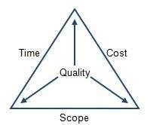
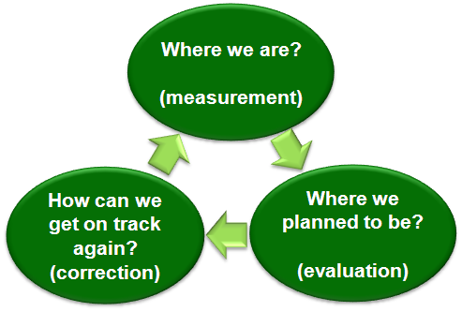
The Blinkered PM
Notes:
https://i.stack.imgur.com/y0w5v.jpg
https://bridgethegulfproject.org/key-topics/economy-and-work

Slide 4
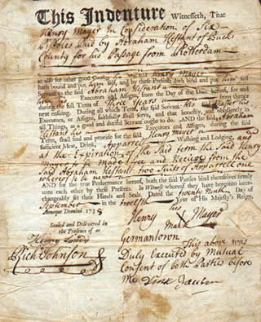
The Background Scramble
The Escalating Risk
Changing risk landscape
New regulations
The Forced Risk Acceptance
Un-quantified
Unknown impact
Less understood triggers
This Photo by Unknown Author is licensed under CC BY-SA-NC
Notes:
https://upload.wikimedia.org/wikipedia/commons/8/86/Indenturecertificate.jpg
https://www.peoplematters.in/article/culture/fanning-inner-sparks-possibility-asal-12348

Slide 5
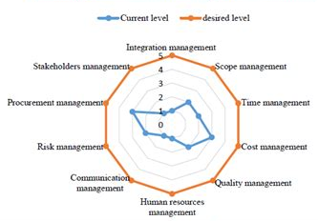
The Risk Assessment
Assessment
Options: Build vs Buy
Evaluation Criteria: Stickiness
Design: Lightweight
Building Capacity: Training
Process & Governance
Notes:
http://dcu.autism-uni.org/wp-content/uploads/2020/09/Form-icon-Assessment-Checklist-Organisation-Time-Management-Budgeting-etc..png
https://www.abacademies.org/articles-images/academy-of-strategic-management-maturity-model-19-1-500-g001.png
Background
Options
Evaluation Criteria
Design
Building Capacity
Process and Governance

Slide 6
Assessment Options
Like an Audit
Like a Maturity Framework
Custom Built

Slide 7
Assessment Evaluation
Effective
Easy to incorporate
Clear and Prescriptive
Simple to administer
Comprehensive

Slide 8
Assessment Design
Excel + email + database
Introduction/ Instructions
Data Entry
Typical Values & When to choose them
Mapping to action items
Integrated to Executive Dashboard
Integrated to ticketing system

Slide 9
Assessment Delivery
Building Capacity
Technical background to understand the assessment
Understanding of Corrective Actions and impact
Discretionary questions
Ensuring full coverage of new project launches
Building the assessor mindset
Don’t accept downplayed risks
Work around resistance from the PM
Explain residual risk and implications
Explain Technical Debt

Slide 10
Assessment Governance
Project team meetings
Initial
Intermediate
Pre-Delivery
Assessment process reviews

Slide 11
The Wide Angle View
The Payoff to the PM
Future ready
Risk manager
Faster functional delivery
The Benefits to the Company
Risk based Portfolio management
Residual risk management approach
Can be turned into a competitive advantage
Notes:
http://blogs.ubc.ca/chendricks/files/2016/07/success.png
https://live.staticflickr.com/7409/13953242160_17577f0514_b.jpg

